Slide 1
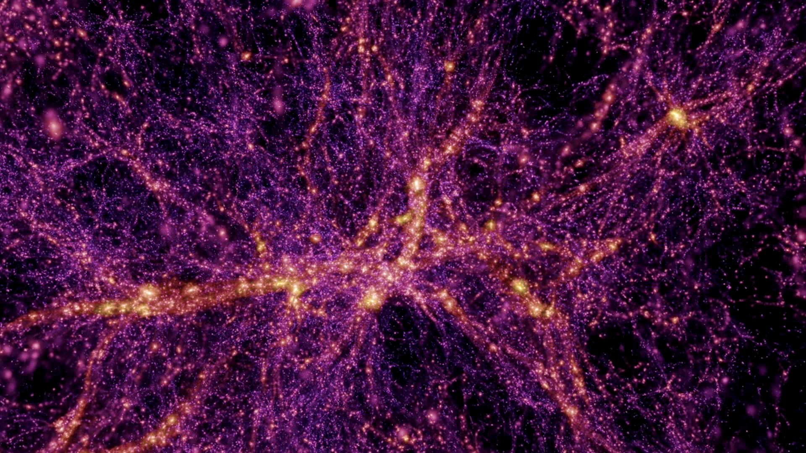
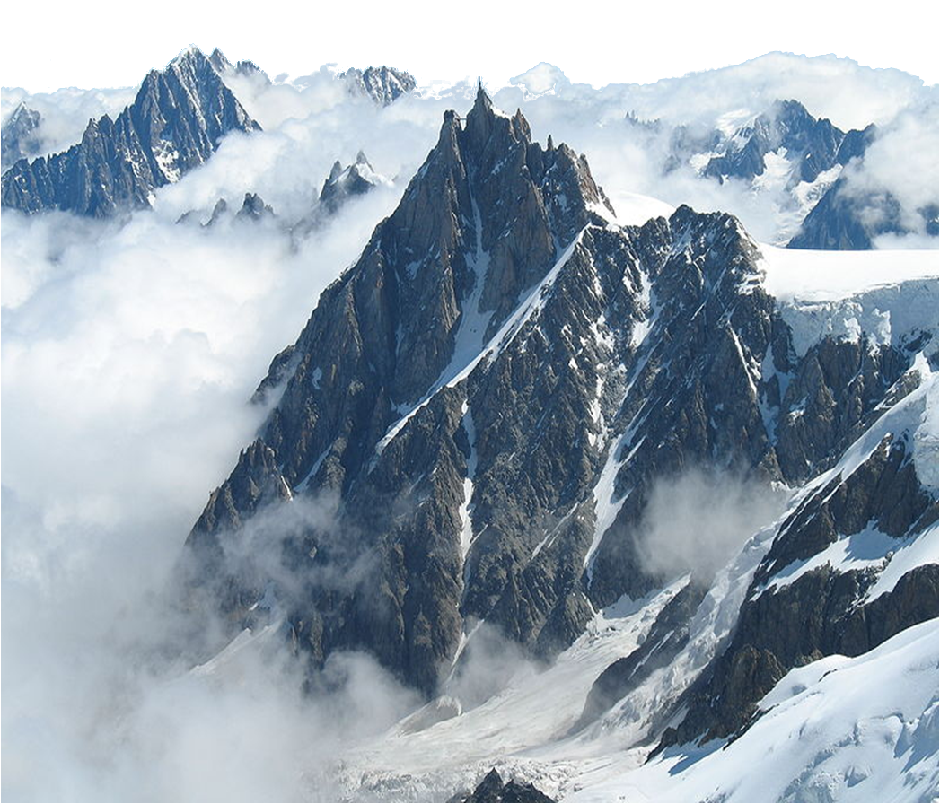
Dark matterLesHouchesAgreement
C. Balázs
Australian Centre
for Particle Physics
Monash University

Slide 2
DLHA
Who Coordinator: C Balázs AMIDAS: C-L Shan DarkSUSY: L Bergström, T Bringmann, G Duda, J Edsjö, P Gondolo DMFIT & DMMW: S Profumo, T Jeltema DRAGON: C Evoli, D Gaggero, D Grasso, L Maccione FeynRules: C Duhr, B Fuks GALPROP: I Moskalenko, E Orlando, T Porter, A Strong ISAJET: H Baer micrOmegas: G Bélanger, F Boudjema, A Pukhov PPPC4DMID: M Cirelli, M Kadastik, P Panci, M Raidal SLHA: S Kreiss, F S Thomas Semi-analytical prop models: T Delahaye, F Donato, J Lavalle, D Maurin, P Salati, R Taillet SuperISO: A Arbey, F Mahmoudi; D G Cerdeno, R Leane, M Kakizaki, S Kraml, C Savage, P Scott, S Sekmen
What Standardized interface for exchanging DM info
Why Enhanced flexibility of DM calculators
How Utilize modularity in DM calculations
Allow user to access I/O for ‘modules’
Let the user ‘go wild’ without hurting anyone
page 2 of 33

Slide 3
DLHA! Why?
Experiment Dark matter signals
DAMA, CoGeNT, CRESST, CDMS-II, XENON100, PAMELA, Fermi-LAT, AMS, WMAP, PLANCK, DanHooper...
Theory Dark matter models
lim_{t→2014}(N) = ∞
It's the golden age of opportunity!
Are these signals “real”?
Which model do they come from?
Start calculating signals in many models!
page 3 of 33

Slide 4
DLHA! Why?
Tools Dark matter calculators
µicrΩmegas, DarkSUSY, SuperIso Relic, ISATools, GalProp, DRAGON, USINE, PPPC4DMID, DMFIT, DMMW, AMIDAS, …
Each has strengts and limitations
Uses use, misuse, abuse = run, tweak, hack
Why use?
Why misuse?
Why abuse?
There’s a need for DLHA
page 4 of 33

Slide 5
Modularity of DM calculations
Lagrangian
Feynman rules
scattering amplitudes
cross sections & decay rates
dark matter abundance
dark matter-nucleon scattering rates
cosmic ray fluxes
neutrino yields
…
page 5 of 33

Slide 6
Modularity of DM calculations
Idea: allow users to ‘access’ individual modules
Lagrangian
Feynman rules
scattering amplitudes
cross sections & decay rates
dark matter abundance
dark matter-nucleon scattering rates
cosmic ray fluxes
neutrino yields
…
tweak here
page 6 of 33

Slide 7
Modularity of DM calculations
DLHA: ‘safe’ tweaking, mixing & matching
Lagrangian
Feynman rules
scattering amplitudes
cross sections & decay rates
dark matter abundance
dark matter-nucleon scattering rates
cosmic ray yields
neutrino yields
…
UFO
Aloha…
DLHA interface
page 7 of 33

Slide 8
Modularity of DM calculations
Example: intercept I/O for the abundance calculation
Lagrangian
Feynman rules
scattering amplitudes
cross sections & decay rates
dark matter abundance
dark matter-nucleon scattering rates
cosmic ray fluxes
neutrino yields
…
BLOCK ABUNDANCE
page 8 of 33

Slide 9
Standardized interface
Example: intercept I/O for the abundance calculation
Module I/O: SLHA style BLOCK format
DLHA fixes: BLOCK names, structure and content
page 9 of 33

Slide 10
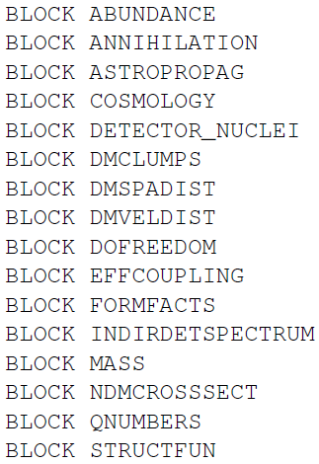
BLOCK list (A-Z)
abundance related info
total & partial annihilation cross sections
propagation model info for charged CRs
cosmological parameters
nuclear structure functions
DM substructures
DM density distribution in astro objects
DM velo. distribution in astro objects
relevant degrees of freedom
effective dark matter-nucleon couplings
nucleon form factors
annihilation/decay spectra in halo/Sun/etc.
standard SLHA block
nucleon-DM elastic scattering cross sections
Les Houches BSM Generator Accord block
nuclear structure functions
page 10 of 33

Slide 11
DLHA vs. SLHA
using & modifying various codes = hacking
page 11 of 33

Slide 12
DLHA vs. SLHA
using & modifying various codes = hacking
SLHA = hacking²
page 12 of 33

Slide 13
DLHA vs. SLHA
using & modifying various codes = hacking
SLHA = hacking²
DLHA = e^{hacking}
page 13 of 33

Slide 14
DLHA challenges
Challenges
(programming) language independence
platform independence
(physics) model independence
particle physics, astrophysics, cosmology
vectors, arrays, tables, functions, methods
speed, flexibility, ease of use, tranparency
reader/writer
…
page 14 of 33

Slide 15
FUNCTION
SLHA type BLOCK useful for I/O of single values
To facilitate function I/O, DLHA introduces
type = P for a predefined function
type = C for a C function
type = F for a FORTRAN function
type = T for a tabular function
type = L for a pre-compiled library function
DLHA specifies: function names, arguments, parameters, predefined assignments
page 15 of 33

Slide 16
FUNCTION list (A-Z)
FUNCTION EnerLoss energy loss coefficient
FUNCTION F_A nuclear structure function
FUNCTION fv_g dark matter velocity distribution
FUNCTION g_eff effective degrees of freedom of thermal bath
FUNCTION gstar effective degrees of freedom of thermal bath
FUNCTION h_eff effective degrees of freedom of thermal bath
FUNCTION Hubble normalized Hubble expansion rate
FUNCTION rho_D ‘dark’energy density - non-standard cosmologies
FUNCTION rho_g shape of the dark matter density distribution
FUNCTION S_ij nuclear structure function
FUNCTION s_D ‘dark’entropy density - non-standard cosmologies
FUNCTION Sigma_D ‘dark’entropy prod. rate - non-st. cosmologies
FUNCTION SpatDiff spatial diffusion coefficient
page 16 of 33

Slide 17
FUNCTION list (A-Z)
FUNCTION EnerLoss energy loss coefficient
FUNCTION F_A nuclear structure function
FUNCTION fv_g dark matter velocity distribution
FUNCTION g_eff effective degrees of freedom of thermal bath
FUNCTION gstar effective degrees of freedom of thermal bath
FUNCTION h_eff effective degrees of freedom of thermal bath
FUNCTION Hubble normalized Hubble expansion rate
FUNCTION rho_D ‘dark’energy density - non-standard cosmologies
FUNCTION rho_g shape of the dark matter density distribution
FUNCTION S_ij nuclear structure function
FUNCTION s_D ‘dark’entropy density - non-standard cosmologies
FUNCTION Sigma_D ‘dark’entropy prod. rate - non-st. cosmologies
FUNCTION SpatDiff spatial diffusion coefficient
page 17 of 33

Slide 18
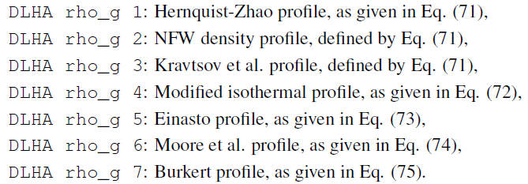
FUNCTION examples
DM galactic distributions: predefined profiles
page 18 of 33

Slide 19
FUNCTION examples
DM galactic distributions: predefined profiles
page 19 of 33

Slide 20
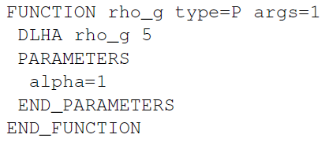
FUNCTION examples
DM galactic distributions: Einasto profile
A DLHA file may refer to this as a predefined object:
page 20 of 33

Slide 21
FUNCTION examples
DM galactic distributions: Einasto profile
… or as a C language object:
page 21 of 33

Slide 22
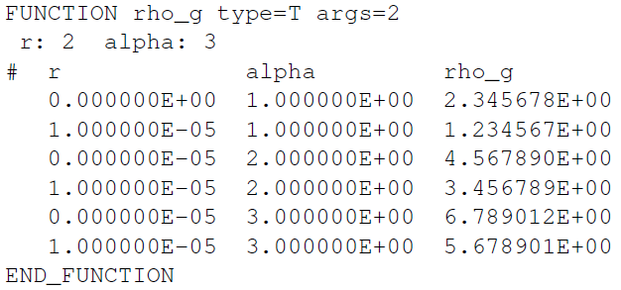
FUNCTION examples
DM galactic distributions: Einasto profile
… or as a tabular object:
page 22 of 33

Slide 23
FUNCTION examples
DM galactic distributions: Einasto profile
… or as a compiled (library) object:
FUNCTION rho_g type=L args=2
libName=libisared.a
funcName=rhoEinasto
END_FUNCTION
page 23 of 33

Slide 24
DLHA Future
DLHA is an agreement at the moment
- we should make it a Les Houches Accord
- that’ll require a bit of tuning it up,
- re-writing it as a journal paper, and
- implementing it in our codes
DLHA is an accord
- so, your suggestions for improvement come …
- here, and
- here, and also
- here …
page 24 of 33

Slide 25
DLHA Future
Having FUNCTIONs, do we need BLOCKs?
- blocks contain constant values
- a constant is a function with zero independent variables and a parameter
- any BLOCK can be replaced by one or more FUNCTIONs
FUNCTION consistency and foolprofing
- make arguments explicit
- clarify difference between variable & parameter
Improve consistency & overlap issues
page 25 of 33

Slide 26
DLHA Future
FUNCTION face-lift
FUNCTION name=<name> type=<type> dim=<# of components>
ARGUMENTS
<argument name 1> <argument name 2> <argument name 3> ...
END_ARGUMENTS
PARAMETERS <parameter name 1> = <value 1> <parameter name 2> = <value 2> <parameter name 3> = <value 3> ...
END_PARAMETERS
<function body>
END_FUNCTION
page 26 of 33

Slide 27
DLHA Future
Compatibility/compliancy
- DLHA is useless unless it’s implemented in dark matter related codes
DLHA Web-page
- keeping track of codes, tools, news, etc.
- twiki style editing???
Standardized I/O?
- standardized reader/writer is desirable
Much more
- see discussions starting after this talk!
page 27 of 33

Slide 28
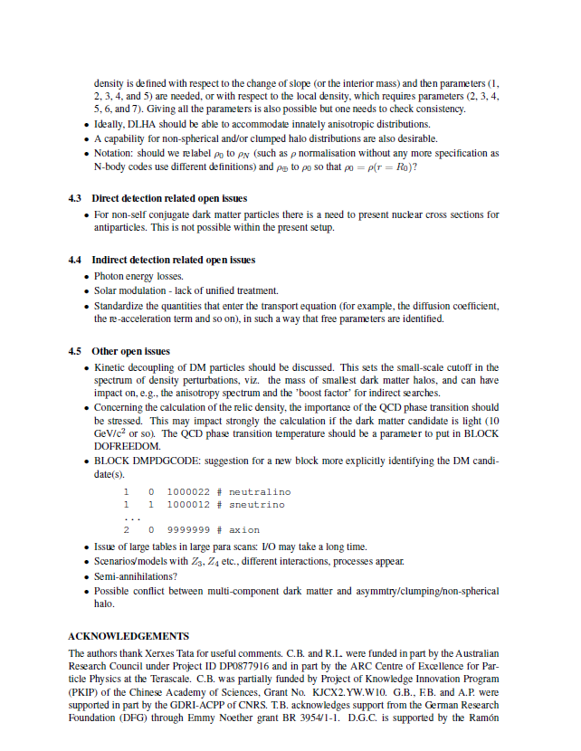
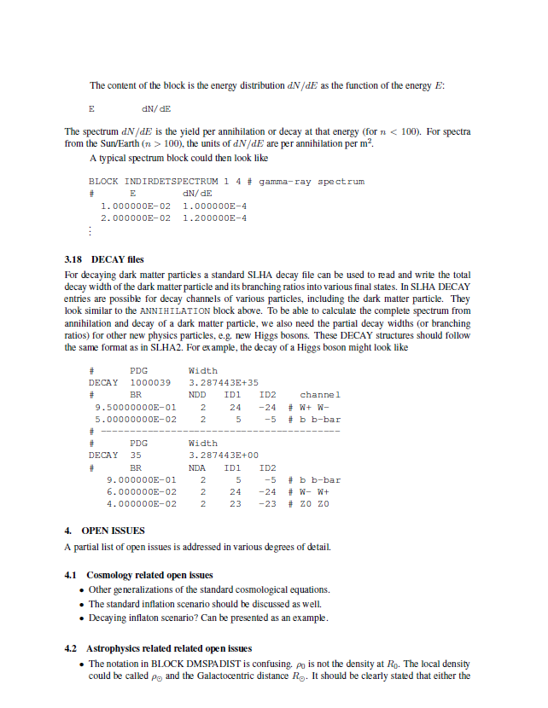
DLHA Future
DLHA:
far from perfect
far from finished
Open issues
From DLHA
write-up
arXiv.1203.1488
page 28 of 33

Slide 29
DLHA Future
help shaping DLHA
discuss, discuss, discuss DLHA
let me know what you think
csaba.balazs@monash.edu
page 29 of 33

Slide 30
DLHA Future
help to shape DLHA
discuss, discuss, discuss DLHA
let me know what you think
csaba.balazs@monash.edu
ITERATE
page 30 of 33

Slide 31
DLHA
Who Coordinator: C Balázs AMIDAS: C-L Shan DarkSUSY: L Bergström, T Bringmann, G Duda, J Edsjö, P Gondolo DMFIT & DMMW: S Profumo, T Jeltema DRAGON: C Evoli, D Gaggero, D Grasso, L Maccione FeynRules: C Duhr, B Fuks GALPROP: I Moskalenko, E Orlando, T Porter, A Strong ISAJET: H Baer micrOmegas: G Bélanger, F Boudjema, A Pukhov PPPC4DMID: M Cirelli, M Kadastik, P Panci, M Raidal SLHA: S Kreiss, F S Thomas Semi-analytical prop models: T Delahaye, F Donato, J Lavalle, D Maurin, P Salati, R Taillet SuperISO: A Arbey, F Mahmoudi; D G Cerdeno, R Leane, M Kakizaki, S Kraml, C Savage, P Scott, S Sekmen
What Standardized interface for exchanging DM info
Why Enhanced flexibility of DM calculators
How Utilize modularity in DM calculations
Allow user to access I/O for ‘modules’
Let the user ‘go wild’ without hurting anyone
page 31 of 33

Slide 32
The End

Slide 33
The End … of this talk but just the beginning of DLHA

Slide 34
Old slides

Slide 35
DLHA Why
Present workflow
MicrOmegas
[Lagrangian]
Feynman rules
amplitudes
cross sections
standard cosmo
DM abundance
direct detection
CR propagation
indirect det.
DarkSUSY
particle models
standard cosmo
DM abundance
direct detection
CR propagation
indirect det.
SuperIsoRelic
particle models
non-stand cosmo
DM abundance
GalProp
CR propagation
indirect det.
page 35 of 33

Slide 36
DLHA Why
Present workflow
Rigid☹
MicrOmegas
[Lagrangian]
Feynman rules
amplitudes
cross sections
standard cosmo
DM abundance
direct detection
CR propagation
indirect det.
DarkSUSY
particle models
standard cosmo
DM abundance
direct detection
CR propagation
indirect det.
SuperIsoRelic
particle models
non-stand cosmo
DM abundance
GalProp
CR propagation
indirect det.
page 36 of 33

Slide 37
DLHA Why
DLHA workflow
MicrOmegas
[Lagrangian]
Feynman rules
amplitudes
cross sections
standard cosmo
DM abundance
direct detection
CR propagation
indirect det.
DarkSUSY
particle models
standard cosmo
DM abundance
direct detection
CR propagation
indirect det.
SuperIsoRelic
particle models
non-stand cosmo
DM abundance
GalProp
CR propagation
indirect det.
page 37 of 33

Slide 38
DLHA Why
DLHA workflow
Flexy☺
MicrOmegas
[Lagrangian]
Feynman rules
amplitudes
cross sections
standard cosmo
DM abundance
direct detection
CR propagation
indirect det.
DarkSUSY
particle models
standard cosmo
DM abundance
direct detection
CR propagation
indirect det.
SuperIsoRelic
particle models
non-stand cosmo
DM abundance
GalProp
CR propagation
indirect det.
page 38 of 33

